Slide 1

苏州诺亚智造科技有限公司 NOAH ITECH (SUZHOU) CO.,LTD

Slide 2
1
公司介绍 Company Profile
公司概述&合作伙伴&组织架构&海外服务据点
Company Overview & Partners & Organizational Structure & Overseas Service Bases
2
核心业务介绍 Core business introduction
自研产品线说明
Self-developed product line description

Slide 3

公司介绍 Company Profile
企业概况 Company Info
成立日期: 2020年9月
Date of establishment: September 2020
注册资本: 5000万 人民币
Registered capital: 50 million RMB
员工: 286 (研发: 57%);
Employees: 286 (R&D: 57%);
公司地址: 江苏省苏州市吴中区郭巷街道吴淞路892号2幢1-2层
Company Address: Floor 1-2, Building 2, No. 892, Wusong Road, Guoxiang Street, Wuzhong District, Suzhou City, Jiangsu Province, China
1

Slide 4




公司介绍 Company Profile
合作伙伴 Partner

Slide 5
公司介绍 Company Profile
服务据点 Service base
苏州
研发/大陆交付中心
Suzhou
R&D/Continental Delivery Center
台湾
海外交付中心
Taiwan
Overseas delivery center
THAILAND
& VIETNAM
MEXICO
CHONGQING
HEFEI
SHANGHAI
TAIWAN
SUZHOU
墨西哥
泰国&越南
重庆
合肥
上海
台湾
苏州
服务据点
Service base
服务据点
Service base
服务据点
Service base
服务据点
Service base
服务据点
Service base
海外交付中心
研发&
大陆交付中心

Slide 6
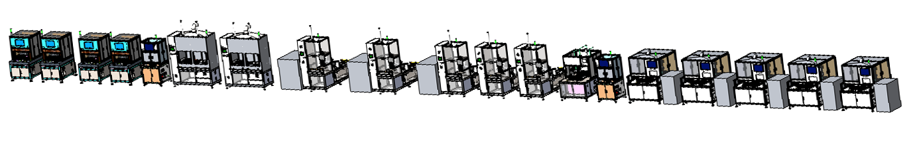
自动线介绍 Introduction of automatic line
冷凝板制程段产品体系 Product System of Cold Plate Process Section
公司产品已覆盖行车电脑中冷凝板制程的组装工艺设备，并成功实现了行车电脑，冷凝板制程设备的规模销售，成为行业内少数几家能够提供冷凝板生产测试自动化系统的企业。
The company's products have covered the assembly process equipment of the cold plate process in the on-board computer, and have successfully realized the car computer. The large-scale sales of cold plate process equipment has become one of the few companies in the industry that can provide automated systems for cold plate production and testing.
气密性测试设备
冲洗设备
烘干设备
激光焊接
Laser Welding
铆接/冲压
Riveting/Stamping
钎焊
Hard-Solder
气密
Leak Test
点胶
Glue dispensing
CNC
冲洗
Washing
热测
Thermal Test
烘干
Dying
检测
激光焊接设备
点胶设备
热测设备
3D量测AOI设备
产品流向
45,000 mm
Total

Slide 7
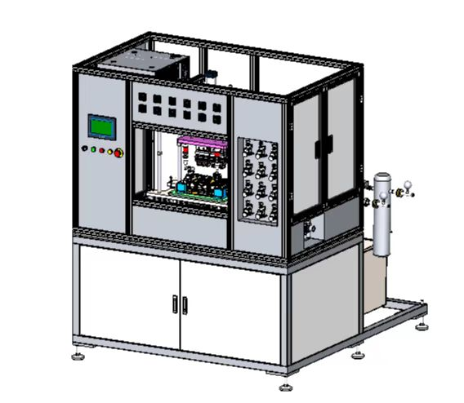
单台设备介绍 Introduction to single device
热测设备 Thermal testing equipment
概览 Overview
热测设备通过上下热测模组模拟芯片与产品接触区域散发热量，水循环系统与产品连接进行内部水路循环, 检测电器元件与产品接触区域温度，根据测温传感器反馈信号并分析数据，来判定产品是否合格设备；The thermal measuring equipment dissipates heat through the upper and lower thermal measuring modules to simulate the contact area between the chip and the product, and the water circulation system is connected with the product to conduct internal water circulation, detect the temperature of the contact area between the electrical components and the product, and determine the product according to the feedback signal of the temperature measuring sensor and analyze the data. Whether the equipment is qualified;
主要技术参数 The main technical parameters
区分 Section | 规格 Spec.
适应产品 Applied Product | 冷凝板 Cold Plate
产品尺寸 Size | Max: 400*300mm
进水流量 Inlet Water Flow | 1-10 LPM
进水温度 Inlet Water Temperature | 10~40 °C
进出水压差 Inlet and Outlet Pressure Difference | ＜ 2100 Pa
测试时间 Test Time | 3min~6min
Load/Unload | 手动方式 Manually
热测设备

Slide 8
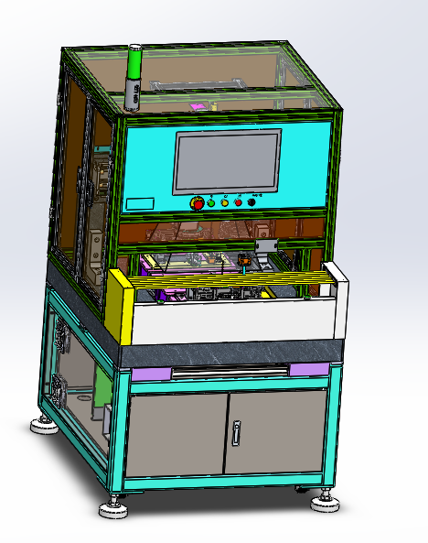
单台设备介绍 Introduction to single device
3D AOI 复合设备 3D AOI composite device
概览 Overview
通过2D和3D相机配合，测量工件的位置度、平面度、轮廓度、直径、零部件缺陷等复合型功能； Through the cooperation of 2D and 3D cameras, it can measure the position, flatness, contour, diameter, component defects and other complex functions of the workpiece;
主要技术参数 The main technical parameters
区分 Section | 规格 Spec.
适应产品 Applied Product | 压铸件&冲压件 Die Casting & Stamping
设备结构 Equipment Structure | 刚结构&大理石 Rigid Structure & Marble
产品尺寸 Size | Max: 400*300mm
设备尺寸 L*W*H | 1150*1000*2000mm
检测精度 Detection accuracy | 2D:0.5um 3D:0.5um
Load/Unload | 手动方式 Manually
相机 Camera | 2D 500万&1200万 各1个(基恩士) 3D 高精度测量测探头(基恩士) 2D 500K & 1200K pixel each (Keyence) 3D High Precision Measuring Probe (Keyence)
3D AOI量测设备

Slide 9
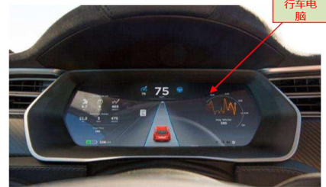
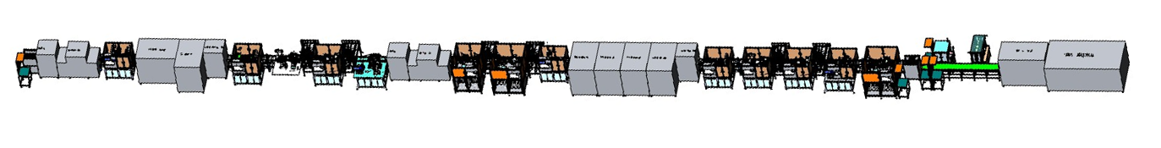
自动线介绍 Introduction of automatic line
行车电脑各制程段产品体系 The product system of each process section of the car computer
公司产品已覆盖知名新能源汽车行车电脑制程的组装系统，并成功实现了行车电脑，制程设备的规模销售，成为行业内少数几家能够提供行车电脑组装无人化系统的企业。 The company's products have covered the assembly system of the well-known new energy vehicle trip computer process, and successfully realized the car computer. The large-scale sales of process equipment has become one of the few companies in the industry that can provide unmanned systems for car computer assembly.
智能称重机 Smart Weighing
智能螺丝机 Automatic Screw Machine
AVI检测机 Automatic Visual Inspection
智能螺丝机 Automatic Screw Machine
AVI检测机 Automatic Visual Inspection
泡棉贴服机 Gasket Machine
智能螺丝机 Automatic Screw Machine
AVI检测机 Automatic Visual Inspection
智能气密性测试机 Air Leak Test
MCU
Cold plate
Bracket
Top
Cover
ECU
Tubes
智能插卡机 Smart Card Inserter
智能贴胶带机 Glue Dispensing
智能贴泡棉机 Gasket Machine
AVI检测机 Automatic Visual Inspection
智能称重机 Smart Weighing
智能螺丝机 Automatic Screw Machine
AVI检测机 Automatic Visual Inspection
智能翻转机 Smart Flipping Machine
智能螺丝机 Automatic Screw Machine
AVI检测机 Automatic Visual Inspection
智能称重机 Smart Weighing
MCU side
49520 mm
ECU side
25,780 mm
75,300 mm
Total

Slide 10
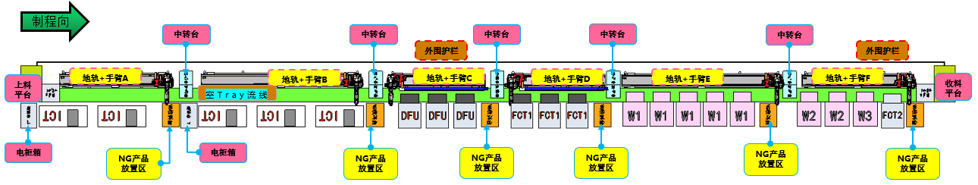
自动线介绍 Introduction of automatic line
笔电各制程段产品体系 Product system of each process segment of notebook computer
公司产品已覆盖笔电制程的组装系统，并成功实现了SMT->LCM->制程产品的规模销售，SMT制程的产品完成开发，部分产品实现了销售，成为行业内少数几家能够提供笔电全系统组装无人化系统的企业。The company's products have covered the assembly system of the notebook process, and have successfully achieved large-scale sales of SMT->LCM->process products. The development of SMT process products has been completed, and some products have been sold, becoming one of the few companies in the industry that can provide notebook computers. Enterprises that assemble unmanned systems in the whole system.
TFT AOI检测设备
模组 AOI 检测设备
TFT (thin-film transistor) dark spots, bright spots, light leakage, line defects, abnormal display
The module AOI backlight is not good, the residual glue is scratched, dirty, white spots, dark spots, etc.
SMT
LCM
FATP
地轨测试自动线
热熔/保压/底盖压合智能机
智能螺丝机
智能插卡机
AVI检测设备
智能贴标机
Hot-melt/pressure-holding/bottom cover pressing intelligent machine
Smart screw machine
Smart card machine
AVI testing equipment
Smart labeling machine

Slide 11
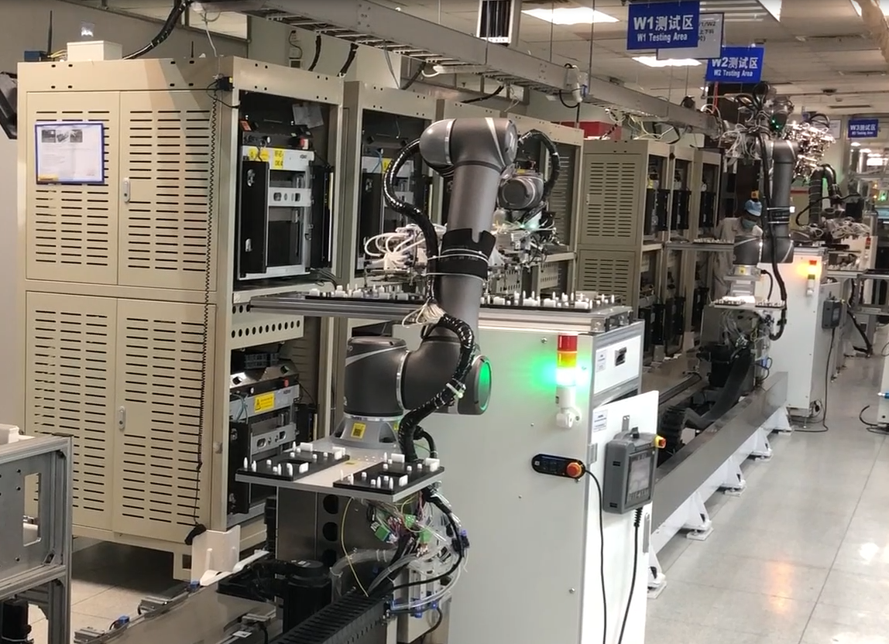
自动线介绍 Introduction of automatic line
SMT地轨测试自动线 SMT ground rail test automatic line
概览 Overview
SMT地轨自动测试线针对笔记本电脑主板测试过程实现无人化自动搬运系统； The SMT ground rail automatic test line realizes an unmanned automatic handling system for the notebook computer test process;
主要技术参数The main technical parameters
项目 Project | 第七轴参数
最大负载 Maximum Load | 80Kg
外部结构 External Structure | 钢结构 Steel Structure
驱动伺服电机 Drive Servo Motor | NACHI servo
驱动方式 Drive Mode | 齿轮减速机 Gear reducer
定位参数 Positioning Parameters | +/-0.5mm
最大行走速度 Maximum Walking Speed | 60m/min
形成范围 Formation Range | 5600mm
运动时最大噪音 Maximum Noise during exercise | ≤80db
Robot model | NACHI
SMT测试自动化

Slide 12
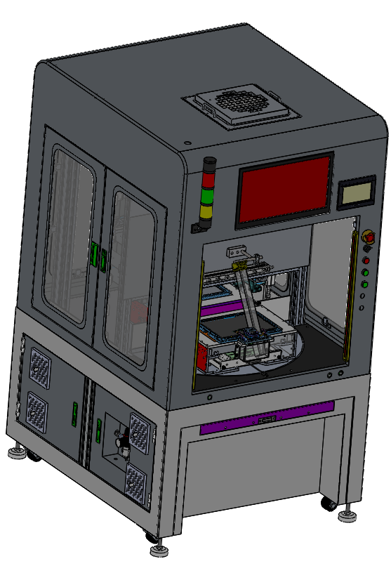
单台设备介绍 Introduction to single device
LCM AOI检测设备 LCM (Liquid Crystal Module) AOI inspection equipment
概览 Overview
AOI检测设备针对屏体不良利用相机自动检测区分良品及不良品检测设备； The AOI testing equipment uses the camera to automatically detect and distinguish the good and bad products for the defective screen body;
主要技术参数The main technical parameters
区分 Section | 规格 Spec.
适应产品 Applied Product | OLED panel/Module ,LCD panel/Module
产品尺寸 Size | 13”~17”
分辨率 Resolution | Maximum 8k
检测标准 Test Standard (Uniformity) | Point＞1/3 subpixel, Line ＞6um， General Mura ＞ Neutral Density Filter 10%， Color Shift Mura ＞ Neutral Density Filter 10%
漏检水准 Missing detection level | 0.1~0.3%
过检水准 Inspection level | 8~10%
Load/Unload | 手动方式 Manually
相机 Camera | 29 Megapixels, 71 Megapixels,151 Megapixels (Brand: I-Teck)

Slide 13
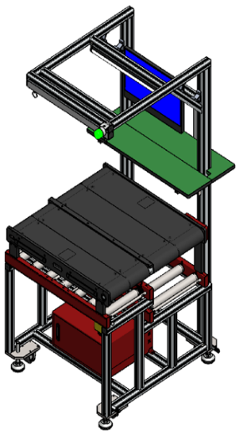
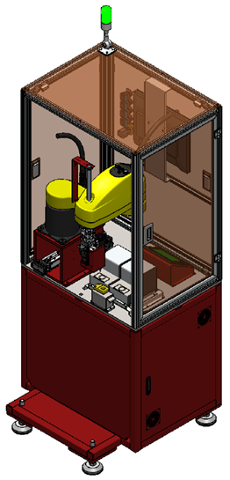
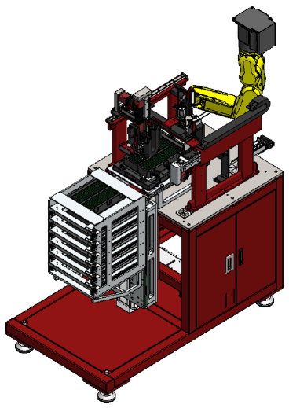
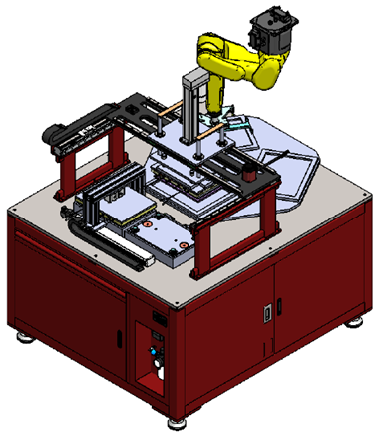
单台设备介绍 Introduction to single device
FATP 自动组装线 Final Assembling Testing Process
人工站 artificial station | 自动螺丝机 Automatic screw machine | 自动插卡机 Automatic card insertion | 热熔/保压/底盖压合智能机 Hot-melt/pressure-holding/bottom cover pressing intelligent machine
功能特色： 1.整线换线单站对 接/拆除时间≤5min； 2.皮带线触发预警提醒 1. The whole line is changed to a single station pair The connection/removal time is less than or equal to 5min; 2. Belt line trigger warning remind | 功能特色： 1.节拍≤2.4s/pcs 2.良率≥99.9% 3.机械手臂循环时间 0.29S，运行速度较 同类产品提高 20~30% 1. Beat≤2.4s/pcs 2. Yield rate≥99.9% 3. Robotic arm cycle time 0.29S, running faster Similar products increase by 20~30% | 功能特色： 1.节拍≤10s/pcs 2.良率≥99.8% 3.重复精度±0.015mm 1. Beat≤10s/pcs 2. Yield rate≥99.8% 3. Repeatability ±0.015mm | 功能特色： 1.节拍≤10s/pcs 2.良率≥99.8% 3.重复精度±0.02mm 1. Beat≤10s/pcs 2. Yield rate≥99.8% 3. Repeatability ±0.02mm

Slide 14
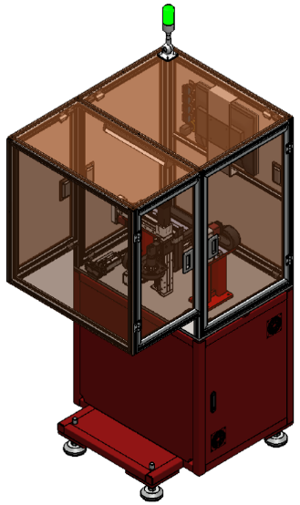
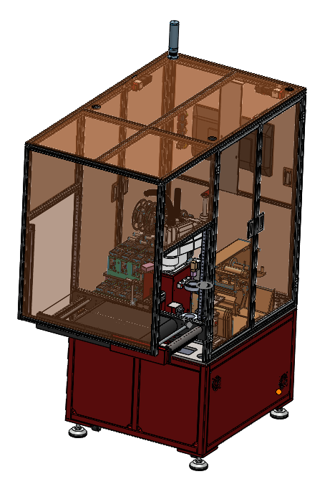
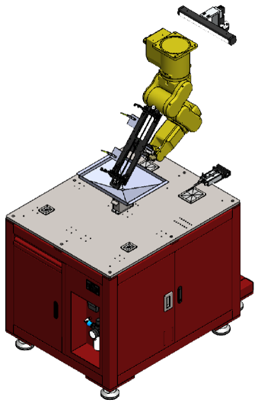
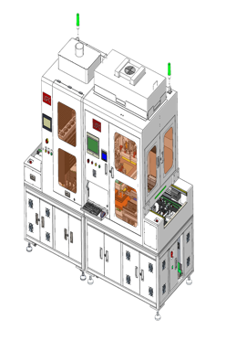
单台设备介绍 Introduction to single device
FATP 自动组装线~智能单机 Final Assembling Testing Process
AVI检测机 Automatic Visual Inspection | 智能贴标机 Labeling Machine | 自动螺丝清理机 Automatic Screw Cleaning | 液态无基保护膜覆膜机 Liquid base-free protective film Laminating machine
功能特色： 1.节拍≤10s/pcs 2.良率≥99.8% 3.适应不同尺寸机型 及检测点位的抓取 1. Beat≤10s/pcs 2. Yield rate≥99.8% 3. Adapt to different size models and the grabbing of detection points | 功能特色： 1.节拍≤10s/pcs 2.良率≥99.9% 3.机械手臂循环时间 0.29S，运行速度较 同类产品提高 20~30% 1. Beat≤10s/pcs 2. Yield rate≥99.9% 3. Robotic arm cycle time 0.29S, running faster Similar products improve 20~30% | 功能特色： 1.节拍≤10s/pcs 2.良率≥100% 3.精度±0.02mm 1. Beat≤10s/pcs 2. Yield rate≥100% 3. Accuracy ±0.02mm | 功能特色： 1.节拍≤10s/pcs 2.良率≥99.5% 3.精度±1μm 1. Beat≤10s/pcs 2. Yield rate≥99.5% 3. Accuracy ±1μm

Slide 15
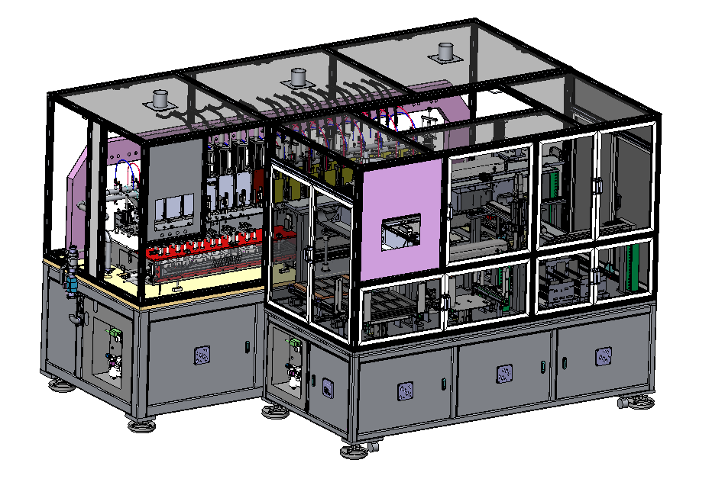
单台设备介绍 Introduction to single device
全自动3D玻璃热弯机 Automatic 3D glass bending machine
概览
全自动3D玻璃热弯机通过成型前的预热段和成型后的持续加热段，可以完全的平衡热应力，并搭配特殊专利的模具设计，实现热弯后玻璃曲线接近89°的玻璃热弯设备； The fully automatic 3D glass bending machine can completely balance the thermal stress through the preheating section before forming and the continuous heating section after forming, and with the special patented mold design, it can achieve glass bending with a glass curve close to 89° after bending. equipment;
主要技术参数The main technical parameters
项目 Project | 规格 Spec.
设备重量 Weight | 2800KG
设备尺寸 L*W*H | 3050*1250*1900
总功率 Total Power | 100KW
平均功耗（KW/H） Average Power Consumption | <30KW/H
良率 Yield Rate | ≥95%
成型周期 Molding Cycle | 30~90s(依据产品形态) (depending on product form)
成型温度 Molding Temperature | 500~850°C
全自动3D玻璃热弯机

Slide 16
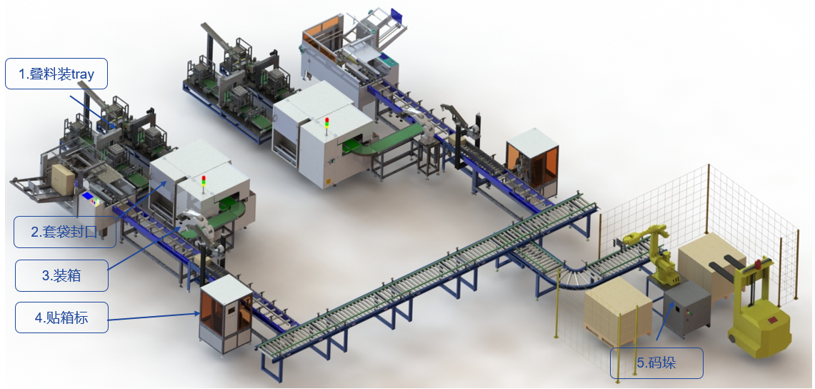
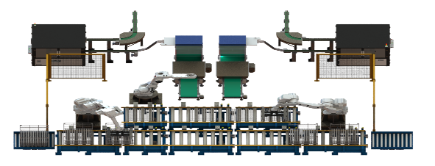
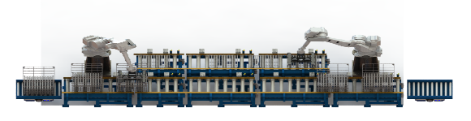
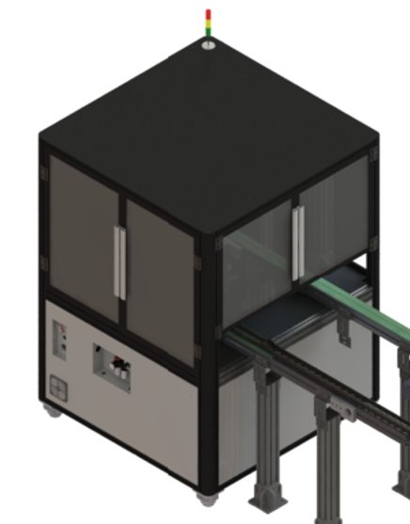
研制中自动线介绍 production under development
4680电池盖全自动生产线 4680 battery cover automatic production line
公司自研4680电池盖全自动高速生产工艺设备，目前部分核心工艺设备模组处于验证阶段，预计5月底验证完成，投入市场应用。设计UPH：18000PCS
The company has self-developed 4680 battery cover automatic high-speed production process equipment. At present, some core process equipment modules are in the verification stage. It is expected that the verification will be completed by the end of May and put into market application.
Design UPH: 18000PCS
开箱设备 Unpacking the device
叠Tray设备 Stacking Tray Equipment
封箱设备 Box sealing equipment
贴标设备 Labeling equipment
密封设备 Sealing equipment
码垛设备 Palletizing equipment
自动里料设备 Automatic lining equipment
自动摆盘设备 Automatic plate placement
清洗设备模 Cleaning equipment mold
原材料
冲压/铆合
Stamping/Riveting
清洗摆盘
Cleaning
产品检测
Inspection
包装
Packing
CCD 检测设备

Slide 17

THANK YOU!

